Slide 1

The forecasting model for the electricity consumption in Quebec - Christopher W. Craighead

Slide 2
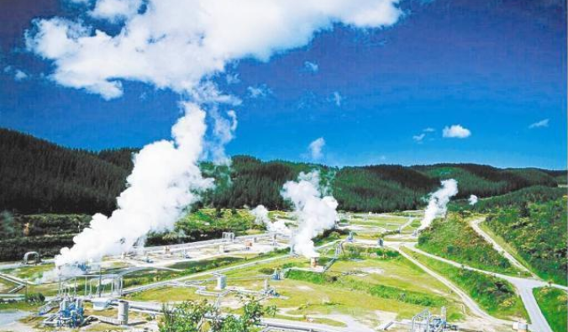
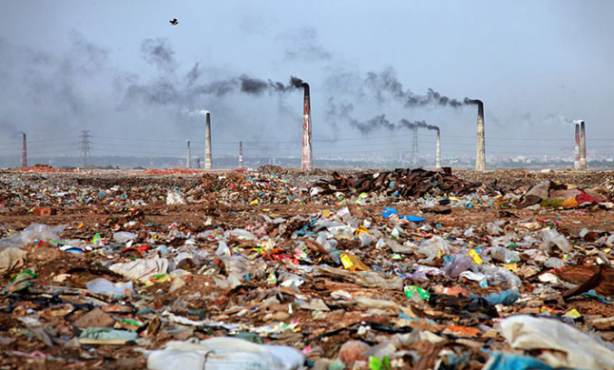
Back ground
Energy shortage
Environmental problem
Notes:
删一点
加一点 objective

Slide 3

Objective
How to plan the production of electric energy strategically to reduce the waste?
Notes:
删一点
加一点 objective

Slide 4
Methodology
Decide variables (Stepwise)
Decide how previous months (12 months) affect the electricity consumption
Built the model
Test the model (R-square, 2 consumptions)
Notes:
删一点
加一点 objective

Slide 5





Quantitative Variables
Unemployment numbers
Electricity price(> 5000watts and < 5000 watts)
Population
Temperature
Hourly salary
Notes:
删一点
加一点 objective

Slide 6

Qualitative Variables
Four seasons
Notes:
删一点
加一点 objective

Slide 7
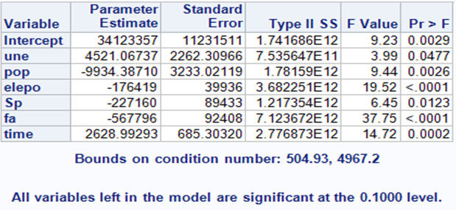
Stepwise selection
Notes:
删一点
加一点 objective

Slide 8
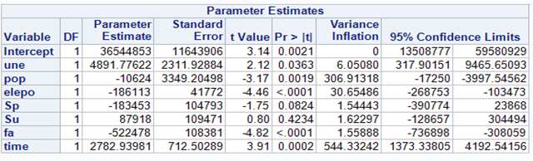
Stepwise selection
Step1: remove pop
Notes:
删一点
加一点 objective

Slide 9
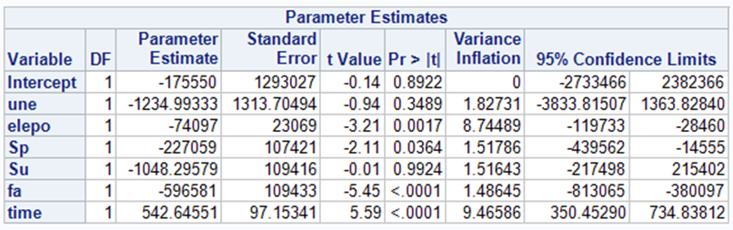
Stepwise selection
Step2: remove une, and su
Notes:
删一点
加一点 objective

Slide 10
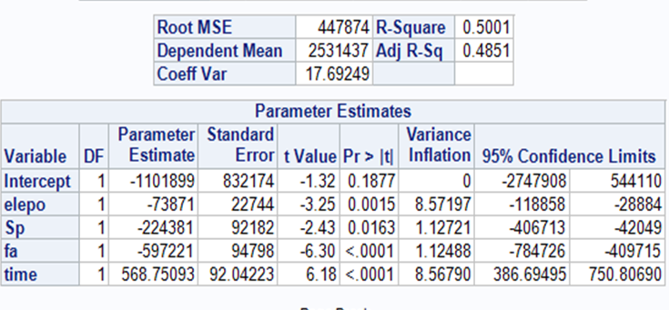
Stepwise selection
Model1: ele = β0 + β1*elepo + β2*sp + β3*fa + β4*wi
Notes:
删一点
加一点 objective

Slide 11
Time series autoregression
Lag1
Lag2
Φ(lag1-lag 12)
Lag3
Lag4
Lag5
Monthly electricity consumption
Lag6
Lag7
Lag8
Φ represents how much the monthly electricity consumption is affected by the specific one previous months
Lag9
Lag10
Lag 12
Lag12
Notes:
删一点
加一点 objective

Slide 12
Time series autoregression
Model ：ele= b0+b1*time + b1*elepo+b2*fa+b3*winter- ϕ1 * Vt-1 – ϕ2 * Vt-2 – ϕ3 * Vt-3 – ϕ4 * Vt-4 – ϕ5 * Vt-5 – ϕ6 * Vt-6 – ϕ7 * Vt-7 – ϕ8 * Vt-8 – ϕ9 * Vt-9 - ϕ10 * Vt-10 - ϕ11 * Vt-11 - ϕ12 * Vt-12 - ϕ13 * Vt-13.
- The first part: the MR model we got previously
The second part: How the monthly electricity consumption is affected by the specific previous months
Φ(n) need to be decided; some lags have significant affection, others’ affections are not significant
Method: Stepwise autoregression
Notes:
删一点
加一点 objective

Slide 13
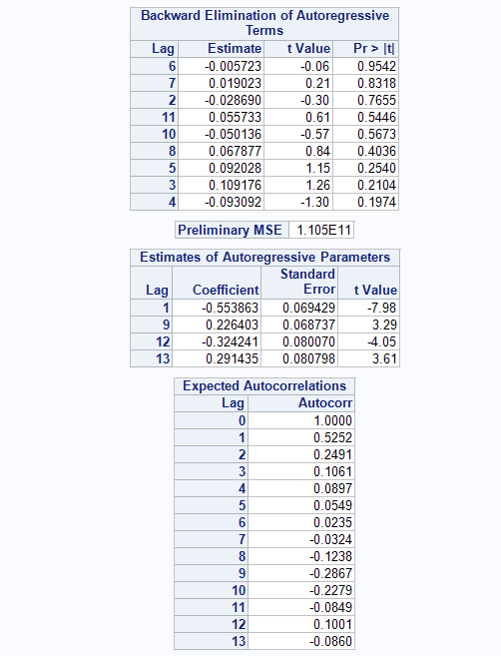
Stepwise autoregression
Model ：ele= b0+b1*time + b1*elepo+b2*fa+b3*winter- ϕ1 * Vt-1 – ϕ9 * Vt-9 - ϕ12 * Vt-12 - ϕ13 * Vt-13
Notes:
删一点
加一点 objective

Slide 14
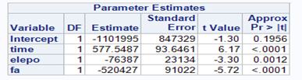
Stepwise autoregression
Model ：ele= b0+b1*time + b1*elepo+b2*fa+b3*winter- ϕ1 * Vt-1 – ϕ9 * Vt-9 - ϕ12 * Vt-12 - ϕ13 * Vt-13
Notes:
删一点
加一点 objective

Slide 15
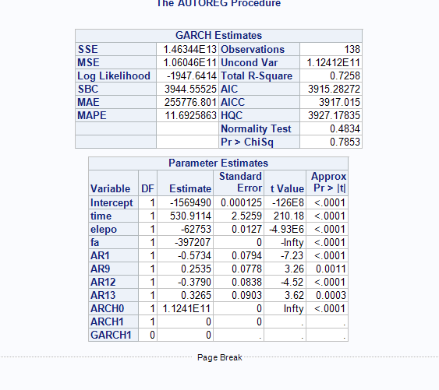
Parameter Estimation
Model ：ele= b0+b1*time + b1*elepo+b2*fa+b3*winter- ϕ1 * Vt-1 – ϕ9 * Vt-9 - ϕ12 * Vt-12 - ϕ13 * Vt-13
- R-square value is 0.7258; P-value is 0.7853
Notes:
删一点
加一点 objective

Slide 16
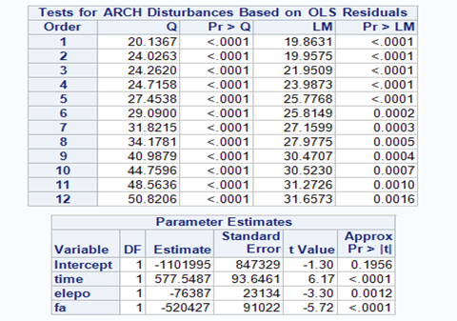
Test for Heteroscedasticity
Methodology: the Q statistics test
The p-values for the test statistics are given in parentheses. These tests strongly indicate heteroscedasticity, with p < 0.0001 for all lag windows.
Notes:
删一点
加一点 objective

Slide 17
Test for Normality
According to the normality analysis, the normality test is not significant (p = 0.483), which supports the normality consumption.
Notes:
删一点
加一点 objective

Slide 18
Future Improvement
The assumption tests need to be done before building the model
- Linearity
- Independence
- Homoscedasticity
- Normality
- No multicollinearity
- Autocorrelation
2. When a lot of predictors are included, overfitting might occur. Ridge and Lasso regression can help reduce Overfitting
3. Sample size can be enlarged to improve the P-value
3. Another future improvement is that the forecasting should be compared with actual data to test the forecasting reliability (RMSE)
4. The last improvement is that the model needs to be tested and updated by repeatedly running the steps with new data.
Notes:
删一点
加一点 objective

Slide 19
Thanks Question?

